Slide 1

Yukon Asset Management Community of Practice Meeting
Department of Highways and Public Works
Transportation Asset Management Unit
Notes:
This presentation provides an overview on the Yukon Government Transportation Division’s approach to utilizing asset management principles to manage various highway asset classes.
As an example, I will provide some work-in-progress examples of the new asset management approaches that we have applied to managing specific programs such as the right-of-way vegetation control program and highway line painting program.

Slide 2
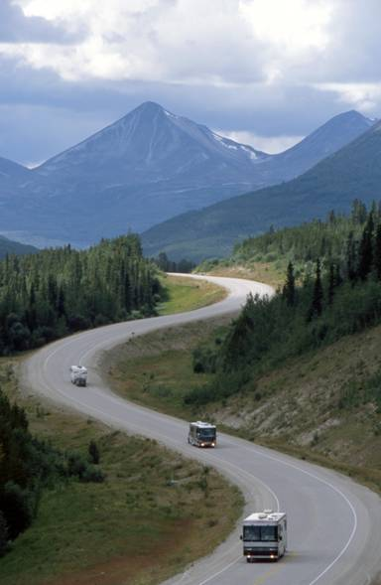
Agenda
Who are we?
Asset Management Principles
Vegetation Management System
Line Painting Program

Slide 3
Who Are We?
Government of Yukon
Department of Highways and Public Works
Michael Zuccarini, P. Eng.
Program Manager - Transportation Asset Management Unit
Transportation Planning Branch
Notes:
The Transportation Division is responsible for managing Yukon’s arterial highways and bridges.
These assets connect communities, transport tourists, and support economic development.
Our group is a newly formed unit (as of November 2018) which took the planning functions from TEB and TMB and merged the people together into one group so that we can perform coordinated planning amongst the transportation branches using asset management principles.
Transportation Asset Management Policy goals and objectives states that we are to define level of service expectations for our transportation infrastructure, monitor performance, and provide information and tools that enable optimized decisions for long-term benefit of Yukoners and visitors.

Slide 4
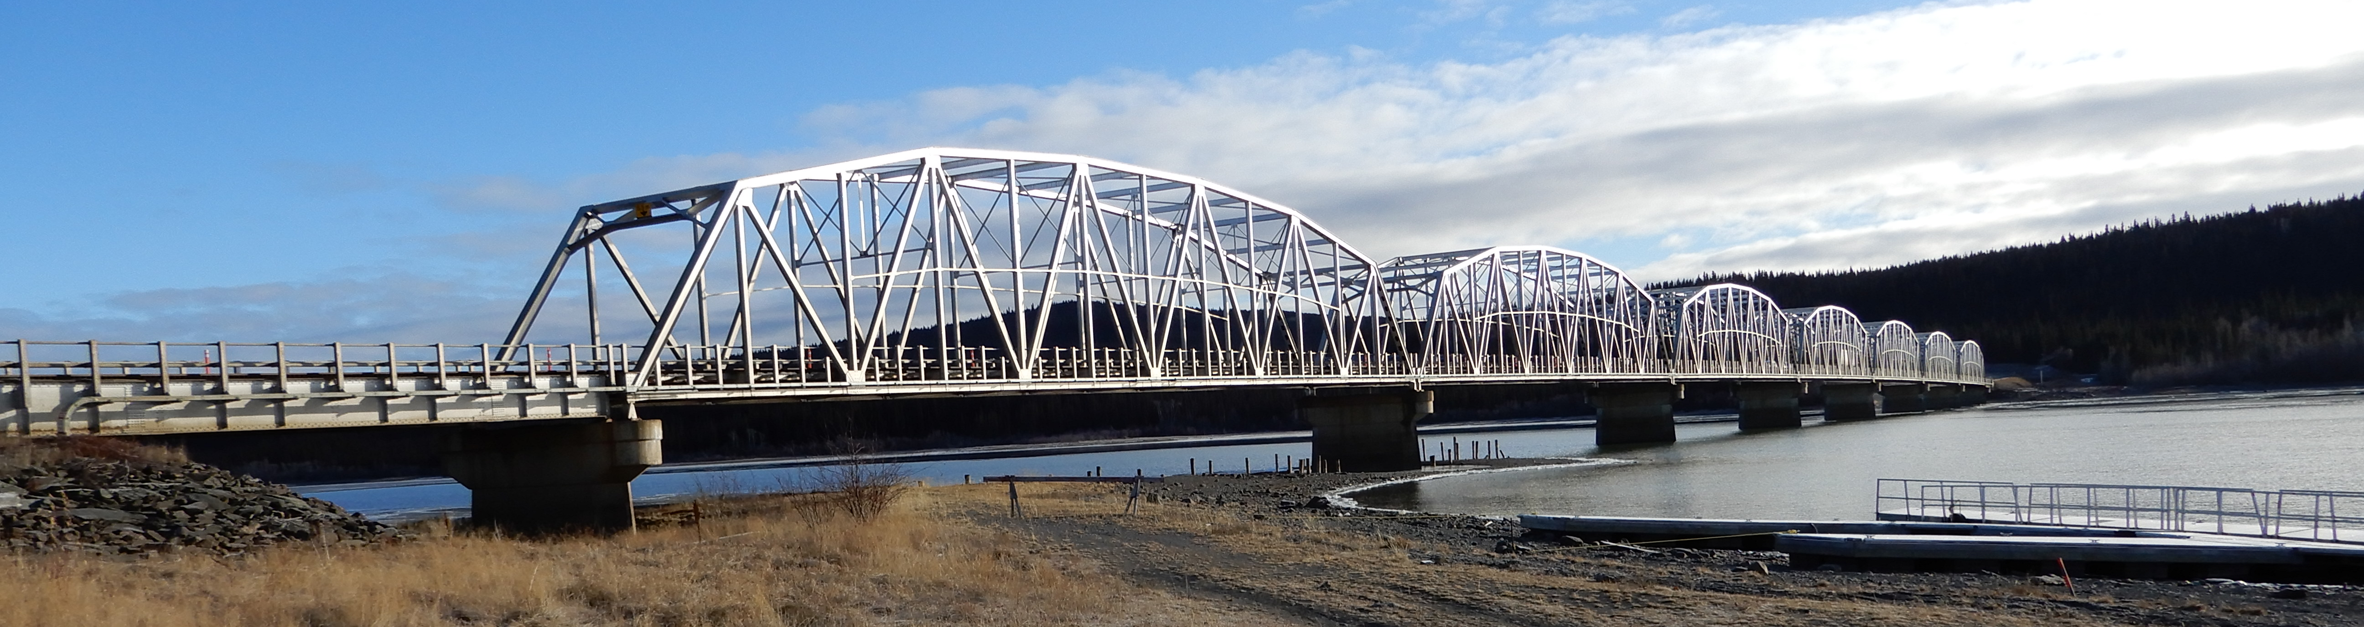
Asset Management
Optimized decision-making
Strategic investment
Notes:
The vision of TAMU is to “lead as a team, making optimized decisions, so that transportation infrastructure exceeds expectations for generations.“
Asset Management is defined as a coordinated activity of an organization to realize the value from assets.
Establishing a formal process for prioritizing roadside safety projects would allow more effective decision making.
Key Tasks for the TAMU Unit include:
- Division-wide development of AMP guidelines and standards to ensure divisional consistency.
Lifecycle strategies, roles and responsibilities, LOS, decision models, KPI's
Long & medium term program planning & budgeting in alignment with functional plans for highway corridors and segments.
Cross-asset prioritization
Condition & Performance Monitoring
Annual project roll-out to project execution units (TEB, TMB, etc.)

Slide 5
Strategic Asset Management Plan
Asset scope
Objectives
Stakeholders
Team structure
Asset-specific plans
Performance measures
Notes:
The Strategic Asset Management Plan is a document that describes the extent of the current Asset Management System and what it encompasses. This includes:
The scope we’re managing – 4,820km of highways with three surface types, bridges and structures, four TC certified airports, 25 aerodromes, fleet
The objectives of the work – service delivery to customers, investment decision-making, continuous improvement
The customers and stakeholders – who they are, what their needs are, how to best hear their voices
The structure of the team – clearly defined roles and responsibilities
Plans for how each asset class will be managed
How performance will be measured – to enable continuous improvement
Aligned with the internationally recognised asset management standard, ISO 55000.

Slide 6
Asset Management Plans
Service delivery to customers
Holistic approach
Investment decision-making
Support for asset management
Measuring effectiveness and continually improving
Specific to each asset class
Qualities, challenges, risks
Timeline to reach objectives
Identifies LoS, state of infrastructure, future demand, life cycle management strategies, financial summaries, plan improvements
Notes:
An asset management plan will be created for each specific asset class.
The Transportation Division’s main objectives focus on the safety, cost effectiveness, capacity, reliability and long-term sustainability of the network.
The plans will outline the characteristics of the asset class in question, the key challenges related to its management (condition, future demand), and how the plan intends to manage the issues or risks associated with the asset class.
The plans will also describe the timeline required to meet the Division’s objectives and close the level of service gap, and the annual cost of doing so.

Slide 7
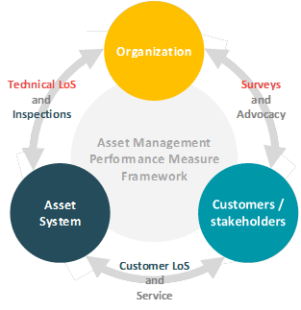
Level of Service
LOS framework
Customer LOS
Technical LOS
Notes:
Levels of Service establish a level of service delivery that balances stakeholder expectations with capacity.
There are two types:
Customer LOS – how services are delivered from the customer’s point of view.
Technical LOS – what the assets need to do to achieve the delivery of services to customers.
This ties in with the functional highway classification system as they can then be used to apply consistent levels of service (LoS) to each category.
Functional Classes Slide
Performance measurement and management of our LoS is central to understanding how we deliver on our asset management objectives.
The Division recently underwent an exercise to classify its primary highways into six level of service classes, based on traffic, tourism, trade, resources, alternate route and communities.
This interim highways functional classification system allows Transportation Division (TD) of Highways and Public Works (HPW) to group highways into like categories based on a consistent, logical and transparent framework
This was done in order to more effectively allocate funding resources to highways based on their specific needs.
Using this interim highways functional classification framework allows Transportation Division to compare the state of primary highways across Yukon, and direct investments where they are needed most.

Slide 8
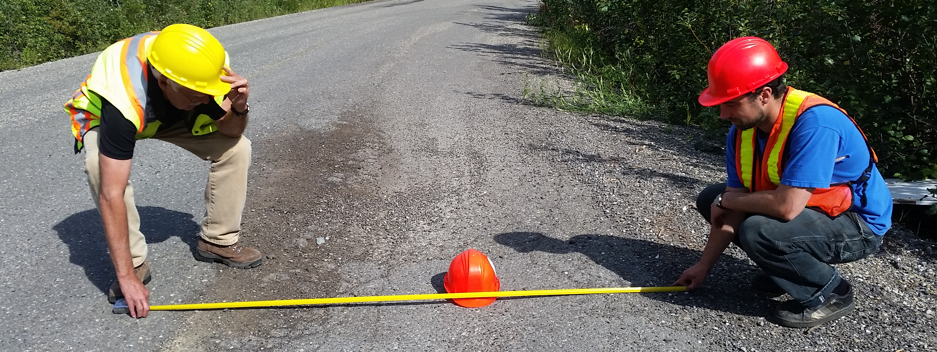
Asset Inventory and
Data Collection
Regular inspection of assets
Asset-specific measures
Databases of components and conditions
Notes:
From spring to fall, we inspect assets to assess their condition. The frequency of inspection is based on capacity and need.
For example, highway surfaces are inspected every year, whereas bridges are inspected every other year.
The type of information we collect is specific to the asset class being inspected.
When inspecting culverts, we look at things like high water mark, inlet obstructions, rust, seam separation …
When inspecting painted lines, we look at brightness of paint, amount of beads left …
When inspecting road surfaces, we look at cracking, ravelling, rutting, potholes, …
In the picture you can see two team members measuring rutting on a chipsealed road.
For every asset class, we keep a database of the individual components and the results of every inspection.
For example, the bridge database has an entry for each bridge in the territory and how it is currently performing.
Condition indexes of the assets are calculated based on information gathered during inspection.

Slide 9
Performance and
Condition Monitoring
Condition Index from inspection data
Monitor trends over time
Trigger values
Notes:
Based on the data recorded during field inspections, a condition index can be calculated for an asset. This is usually a score out of 100 that describes how the asset is performing.
We frequently publish internal reports that show the condition of an asset class with trends over time. This way, we can monitor how assets are performing and identify where we may need to prioritize investment. [something about continuous improvement?]
For some assets, there are set condition index values that trigger rehabilitation. For example, rehab is triggered for an asphalt road surface when the condition reaches 65 (out of 100). Because of the data collected in the annual inspections, we would be aware … [I’m trying to say, if it was 74 two years ago, and 71 last year, and 68 this year, we know that it’s coming up for rehab soon. We can predict the maintenance needs because of our performance monitoring. Good data means timely investments.]
The figure here shows one example of performance monitoring for the sealed highway network.

Slide 10
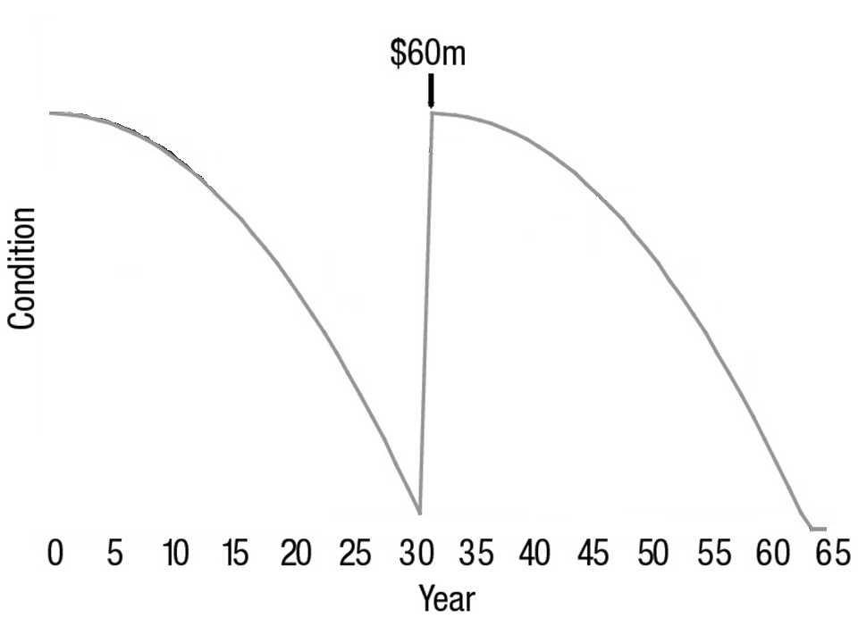
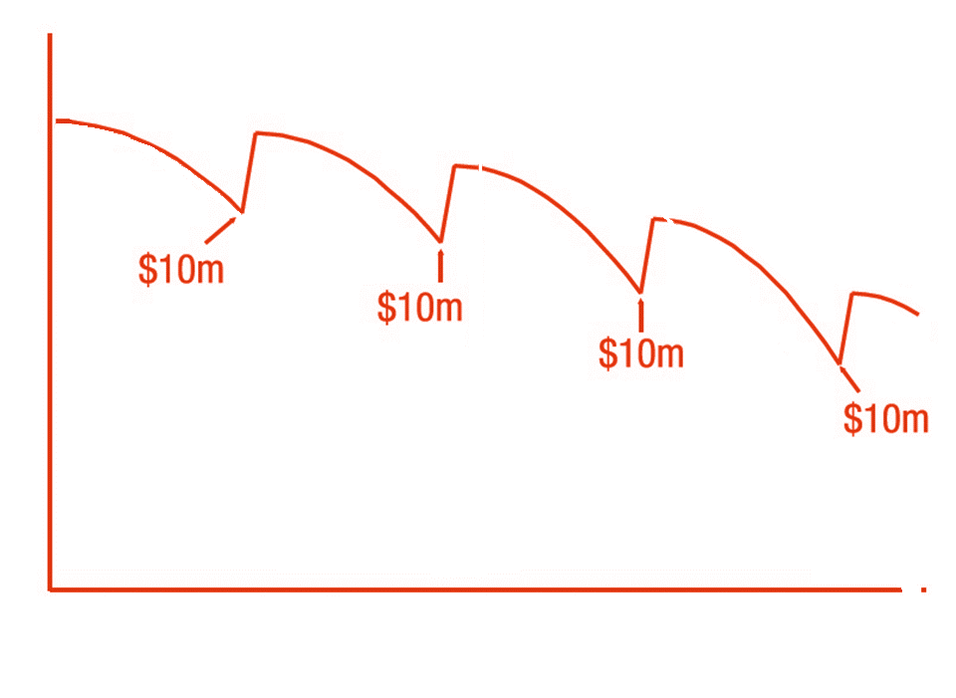
Life Cycle Management
Timely investments save money
Asset management enhances planning
Adapted from Ontario Ministry of Infrastructure, 2012
Notes:
A major benefit of using established systems to manage the condition of our assets is that we can save money by making timely investments.
It is much cheaper to plan regular routine maintenance over the life cycle of an asset than to let it degrade and then replace it.
Monitoring the condition of transportation assets enables us to predict where investments will be needed.
(could compare to a car to make it more clear)
[source: https://www.ontario.ca/page/taking-care-your-drinking-water-guide-members-municipal-councils]

Slide 11
Roles and Responsibilities
RASCI
Tasks | Asset Manager | Data/Inspection Team Lead | Manager D&C | Superintendents, TMB | Manager TAMU | Directors (TEB,TMB,TPB) | GIS Team TAMU |  | DESCRIPTION
Asset Management Plan (AMP) | R | S | C | C | C | A | S |  | Develop, implement and maintain AMP which includes lifecycle strategies, roles and responsibilities, decision models, KPI's, etc. Short Term and long term investment plans
Asset Class Levels of Service (LoS) | R | C | C | C | C | A | I |  | Develop and implement program specific LoS and identify key performance indicators and KPI targets by functional classification.
Data Management Plan | A | R | I | I | C | I | S |  | Develop and maintain the data management model which includes….
Performance Monitoring & Reporting | R | S | S | I | A | I | I |  | Aggregate collected data & information and analyze to understand holistic and wider trends that might be occurring. Audit capital delivery of the annual program in accordance with technical specification and LoS standards to ensure the asset is meeting the required standards.
Asset Managemnet Tools and Process Provision | R | C | I | I | A | I | C |  | Identify and implement management tools that provide overarching insights into how well the AMP is being delivered to the division. Identify and implement tools and processes that target asset management planning such condition assessment databases, inventory databases, data collection specifications and technology, KPI's, etc.
Annual Capital & Maintenance Plans | R | C | C | C | C | A | C |  | Provide annual project selections for capital and maintenance delivery including locations, lengths, scope and cost estimates. Project selections to align with decision model, LoS, AMP, long/medium term program plans and capital budget.
Asset Maintenance (Maintenance Program Delivery) | A | I | I | I | I | I | R |  | Delivery of maintenance strategies and treatments identified in the Annual Plan.
Asset Rehabilitation/Reconstruction/Replacement | A | I | S | R | I | I | I |  | Includes project management and contract management associated with delivery of the short term plans identified by the asset manager.
Notes:
Responsible
Accountable
Support
Consult
Inform
Describes the organization and people who are responsible for the delivery of asset management services .
Ensure that each branch and key position within the organization is aware of their role in managing each of the assets.

Slide 12
Transportation Asset Classes
Roadside Safety Program Assets
Vegetation Control
Barriers
Line Painting
Roadside Delineation
Roadside Obstructions
Signs
Other Assets
Culverts
Road Surfaces
Bridges
Rest Stops
Notes:
The roadside safety program encompasses any infrastructure component that contributes to the safety of users, including…
This presentation goes into depth on line painting and vegetation control but here’s an overview of some of the major components.

Slide 13
Example:
Vegetation Management System (VMS)

Slide 14
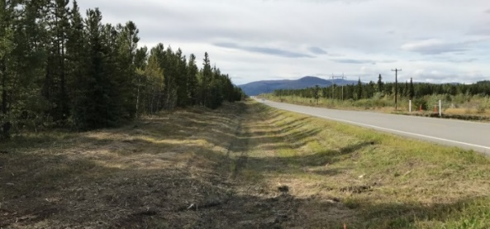
VMS Scope
Brush clearing and tree removal within ROW
Annual basis
Primary and secondary highways and roads
Notes:
VMS: Vegetation Management System
Previous program: Based on a worst first approach, Vegetation along highways is assessed and prioritized based on proximity to communities, traffic volumes, frequency of wildlife collisions, sight lines and vegetation condition, complaint driven at times. Budgetary limitations did not facilitate all highways being cleared on a strategic maintenance cycle.
Revamped program takes an asset management approach to vegetation control which will create a formal process for prioritizing brushing projects and allow for more effective decision making.

Slide 15
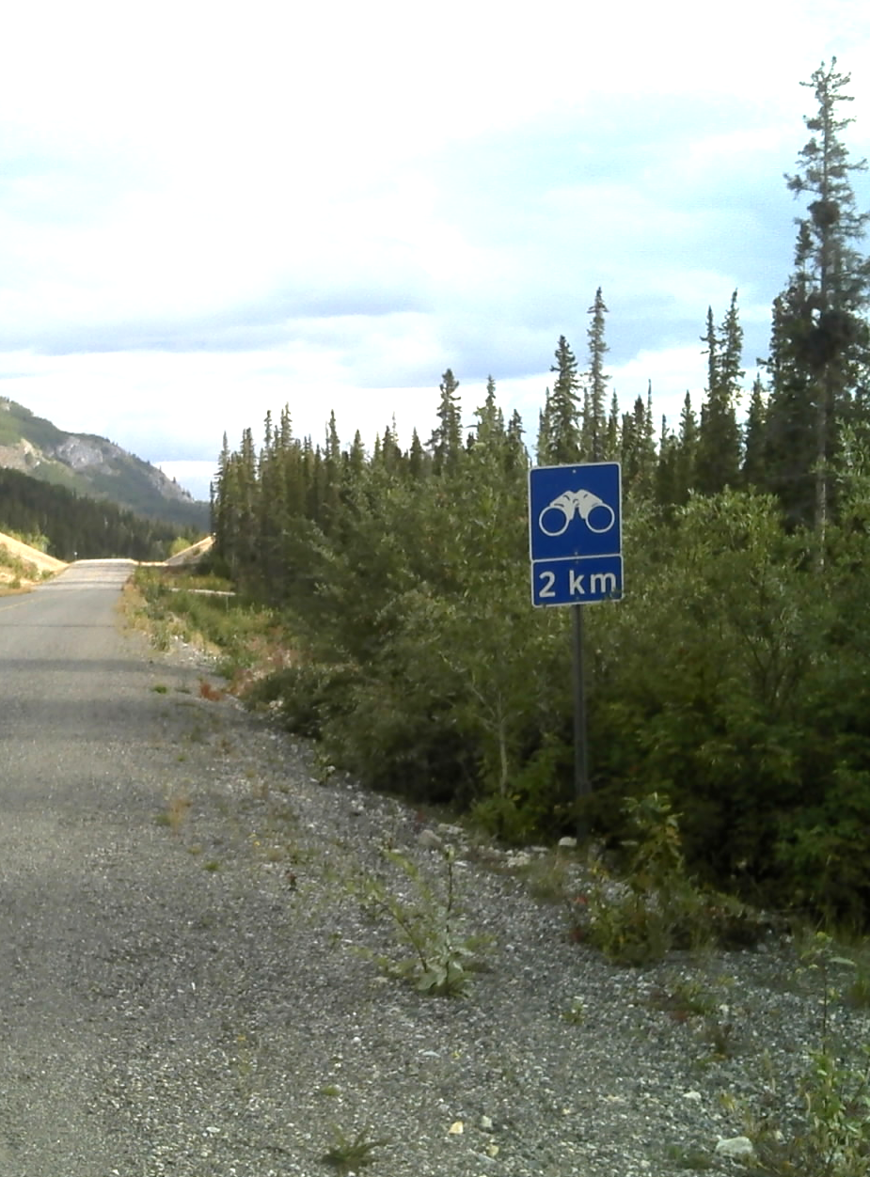
VMS Objectives
Longer sightlines
Wildlife
Clear zone
Drainage
Visibility
Structure
Notes:
There are many reasons that clearing vegetation growth from the roadside is important.
Overgrowth can block drivers’ sightlines, especially around curves.
Wildlife may feed on the growth, bringing them closer to moving vehicles. They will also be more obstructed from view and drivers will have less time to react to an animal on the road.
Any object in the clear zone – and this includes vegetation – can be a hazard during a collision. A vehicle that leaves the roadway may strike a tree, or the vehicle’s likelihood of recovery on an embankment may be reduced.
Overgrown vegetation blocks ditches and culverts and prevents proper drainage on the roadway.
(pictured) Vegetation can block road signs.
Removing vegetation makes pedestrians and cyclists on the roadside more visible.
Root systems may cause heaves and distortions in the road material. Removing the surface plant prevents the roots from growing and increases the life of the road.

Slide 16
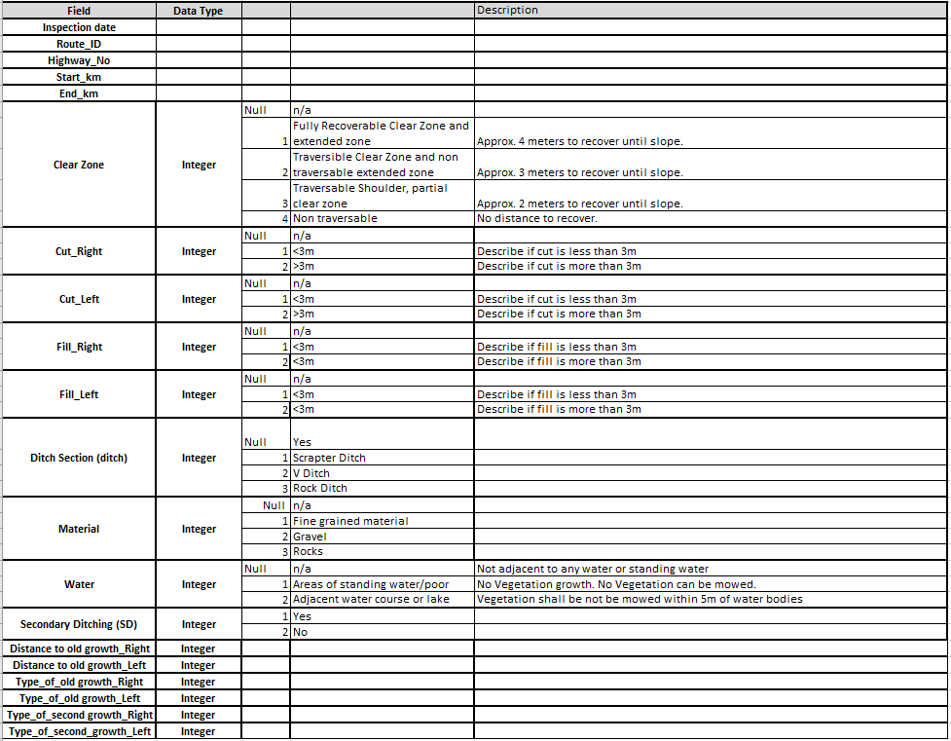
VMS Data Collection – Tombstone
Notes:
Indicates static components of the highway RoW which are related to the vegetation.
Tombstone information is collected only once, unless a major rehab of the highway section occurs.
Tombstone data can be used by the asset manager to help inform decision making regarding appropriate rehab/treatments, costing, etc.

Slide 17
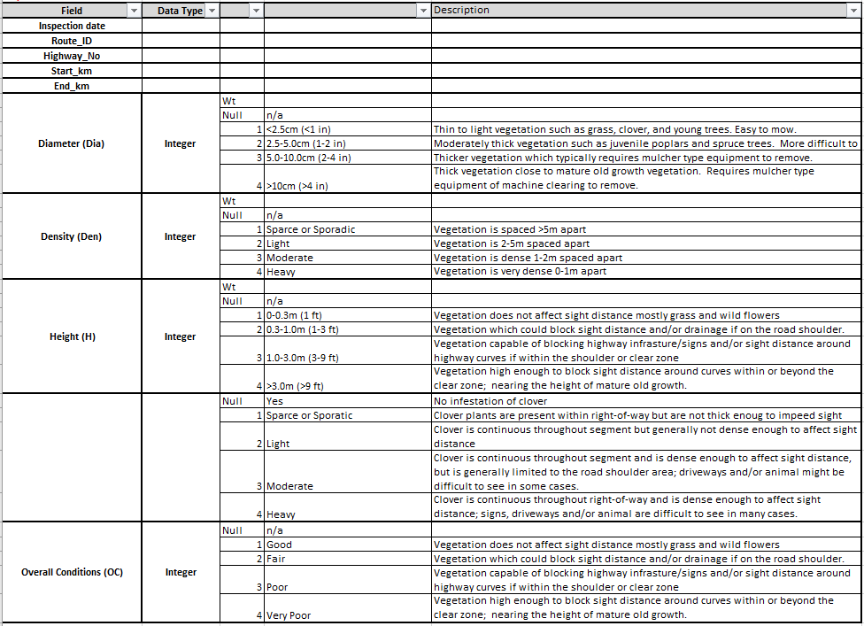
VMS Data Collection – Inspection
Notes:
Indicates dynamic components of the highway RoW which are related to the vegetation.
Information is collected during routine highway inspections
Information is used to calculate a condition index for sections of highway (i.e. rating)
Over time, information can be used to plot deterioration curves and help inform LoS structure/criteria (i.e. height, diameter, density on highway functional class X shall be Y and therefore requires rehab every Z years)

Slide 18
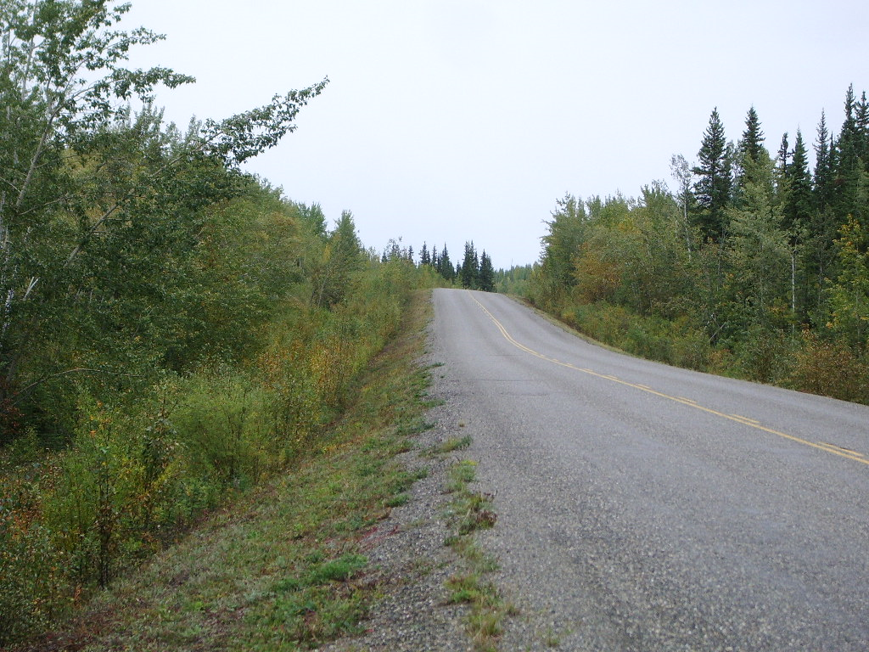
Classifications of Vegetation Control
Class A:
  2.5 m from shoulder
  Clover mowing
  Short-term solution
Notes:
Utilizing same classes for vegetation control work as per previous specifications issue by TMB.

Slide 19
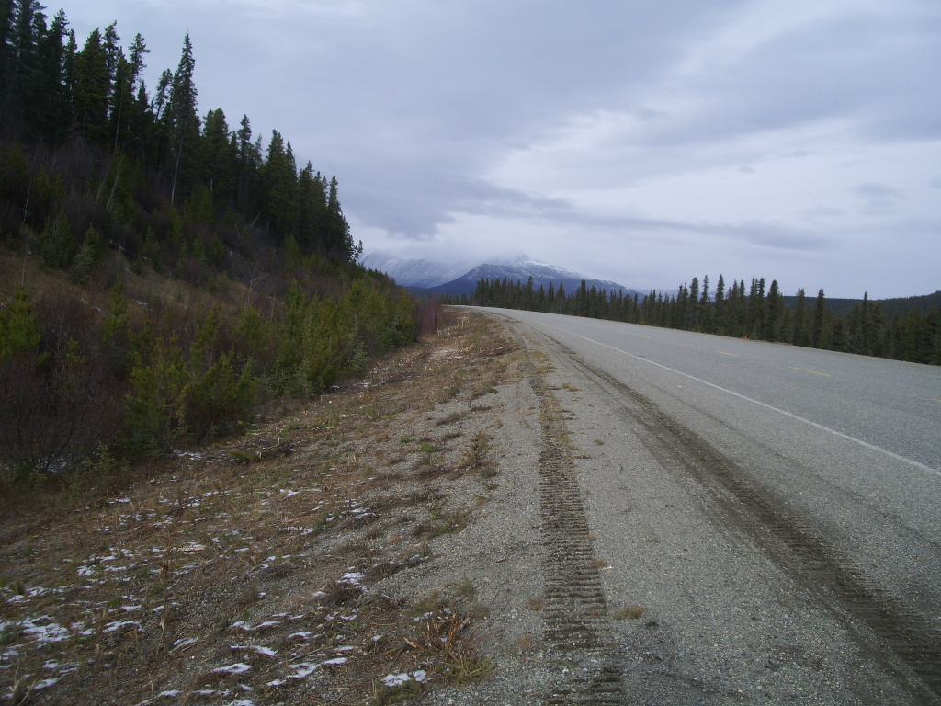
Classifications of Vegetation Control
Class B:
  5.0 m from shoulder
  Sight distances
  Cost-effective

Slide 20
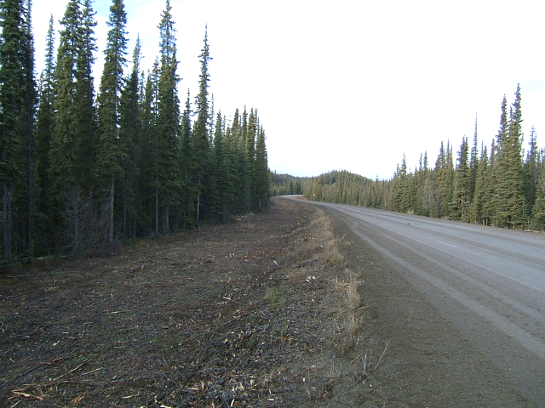
Classifications of Vegetation Control
Class C:
    10.0 m from shoulder
  Narrower ROW and/or secondary roads
  Significant improvement

Slide 21
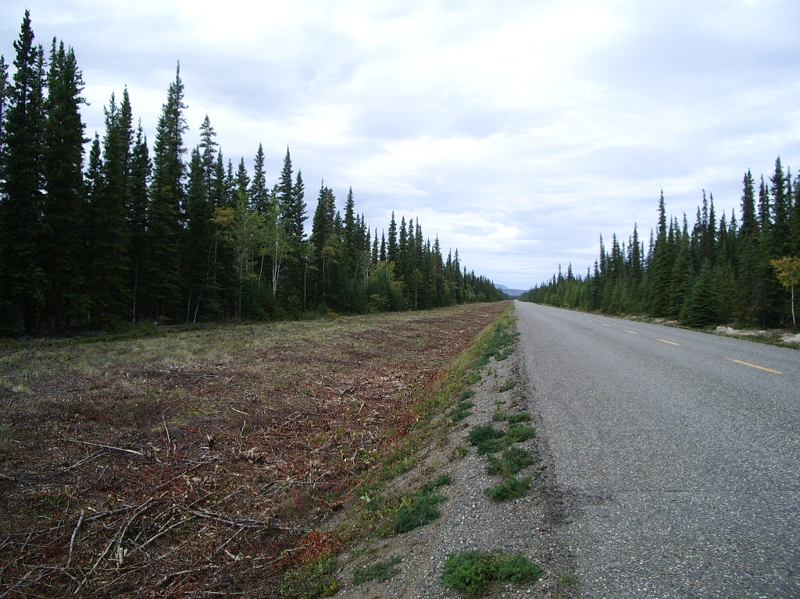
Classifications of Vegetation Control
    Class D:
    Full Width RoW Clearing to the lesser of the following:
      Original mature old growth vegetation
      A transmission line adjacent to the roadway
      The inside of an interceptor ditch
      A private fence
      The surveyed highway right of way (20 to 30 m from centerline)
Notes:
Alaska Highway and Haines Road are identified as 30m from centerline for full width brushing.
All other highways are identified as 20m from centerline for full width brushing.

Slide 22
VMS Levels of Service
VMS Category | Width | Frequency
1 | Full Width 30 m | Annually
2 | Full Width 20 – 30 m | 3 years
3 | Class C 10 m | 3 years
4 | Class C 10 m | 6 years
5 | Class B 5 m | 6 years
6 | Class B 5 m | 12 years
Notes:
This is the six year cycle for vegetation projects.
Includes 6 VMS categories for grouping of all numbered major highway segments, ranked based on importance.
Each VMS category has a prescribed maintenance cycle including frequency of brushing, and width extent of brushing.
This maintenance cycle represents a significant increase in highway network wide RoW brushing compared to past years.

Slide 23
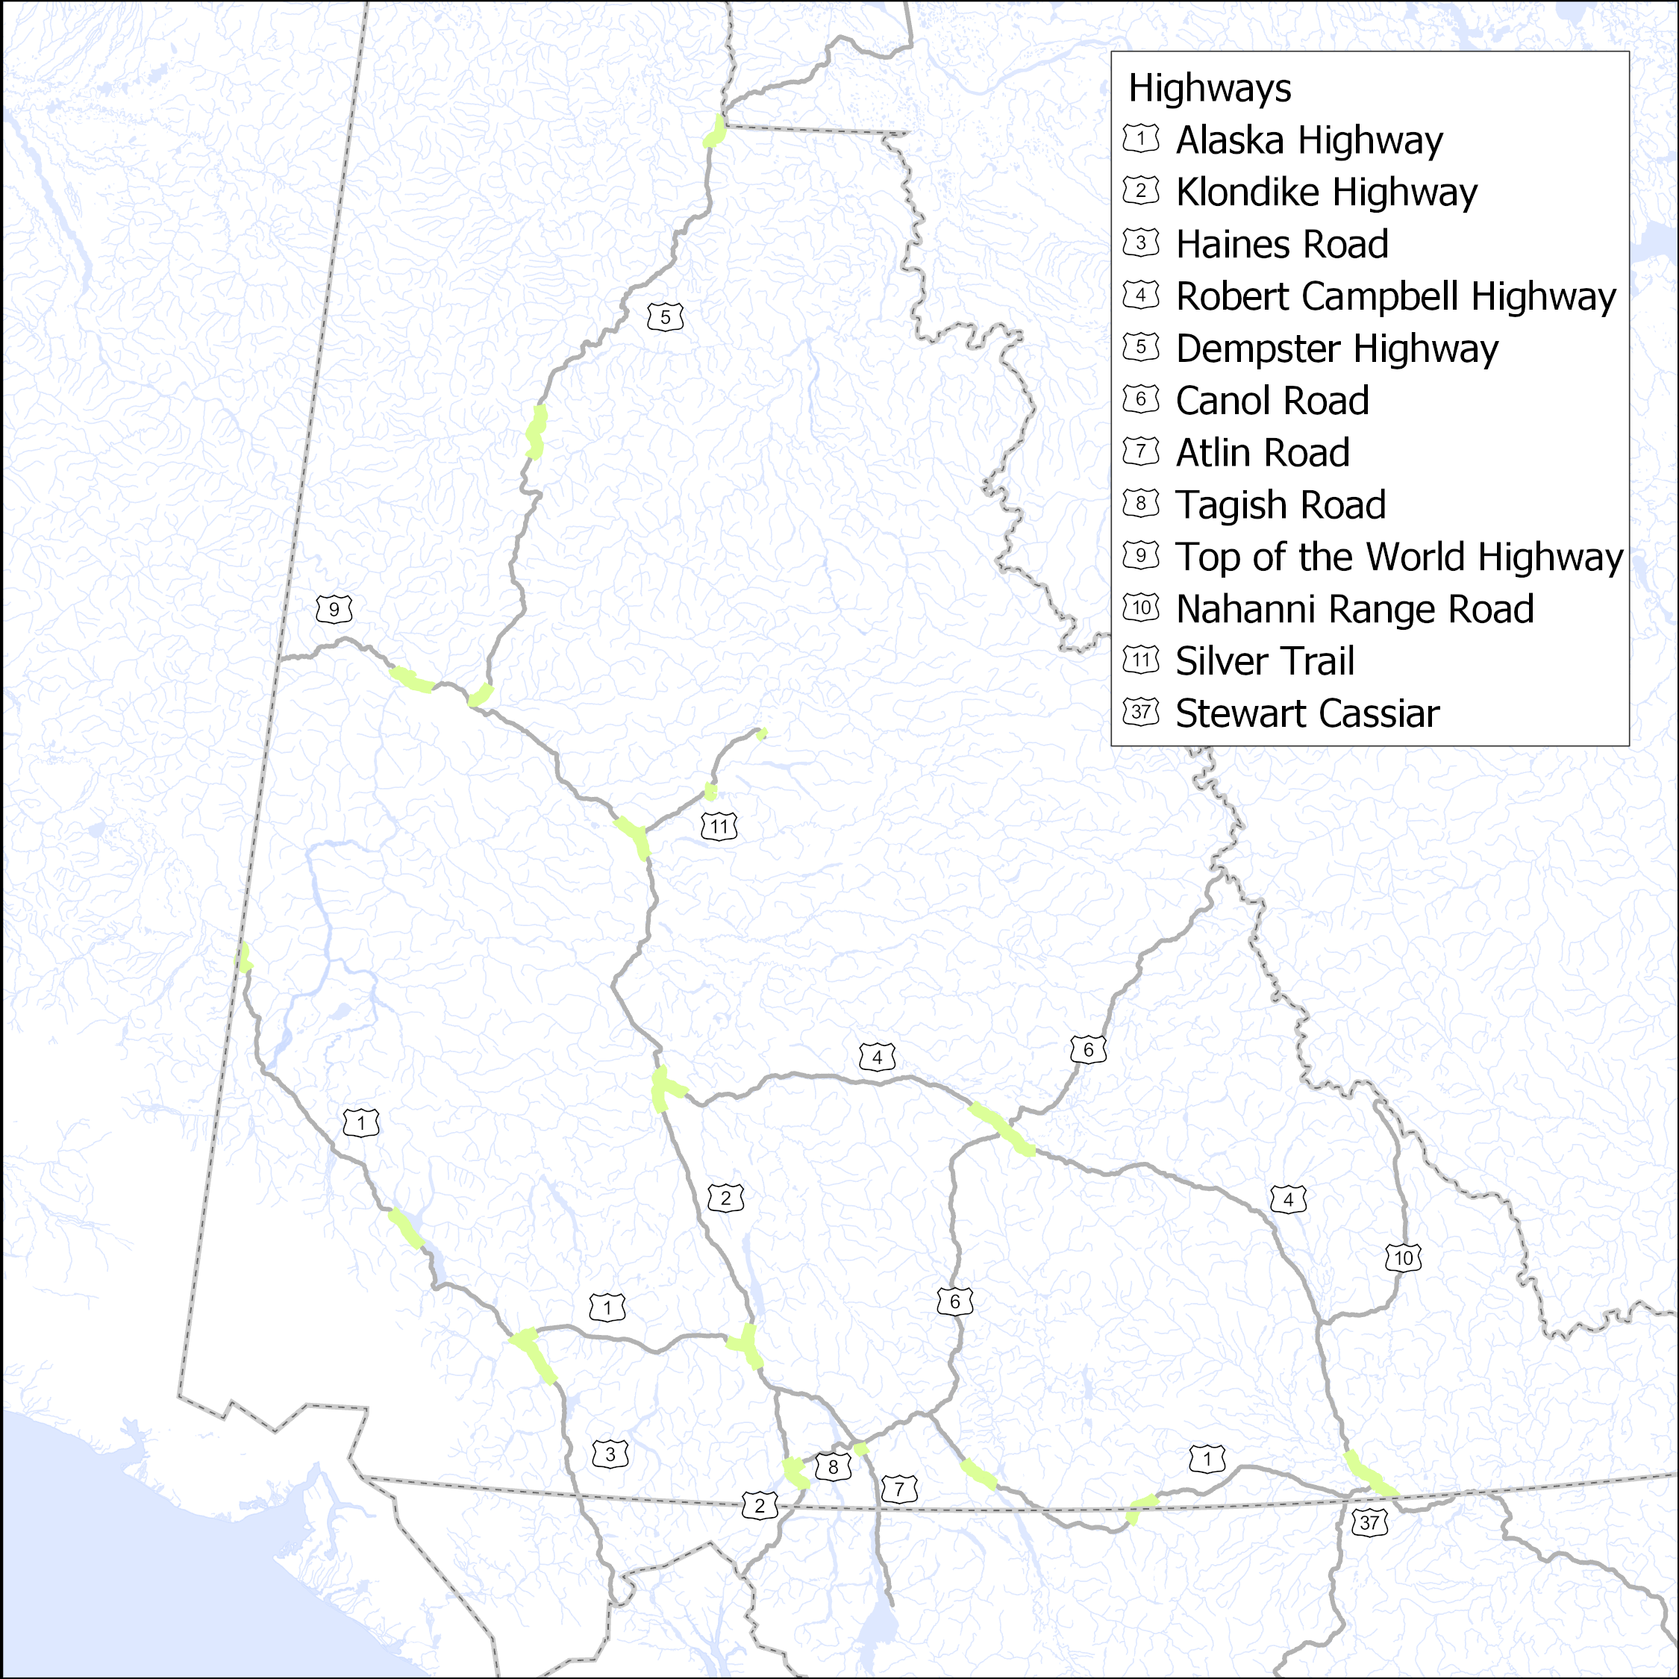
VMS: Year 1 of 6
Notes:
Project selection philosophy:
Funding for category 1 & 2 highways will be concentrated on full width brushing during years ~1-3 (i.e. get caught up). Funding will be concentrated on full width mowing from years ~4-6.
Removed category 6 highways (secondary roads, Canol Highway & Nahanni Range Road) in order to better fit the budget. Secondary roads require data collection prior to any future project selections.
In general, the philosophy behind this project selection has been to start at each major community and brush outwards north, south or both north/south depending on condition ratings, recent brushing history, etc.
Most visible to the communities, most traffic within the communities. Allows for long continuous project sections in lieu of discontinuous sections based on the previous worst first approach of selection projects
Category 1 & 2 highways could make up the large ~500k to ~1.5M dollar contracts (full width), ~2.6M total.
Category 3 & 4 & 5 highways will make up the small local contracts ranging from ~50k to ~200k (Class C & B), ~750k total.

Slide 24
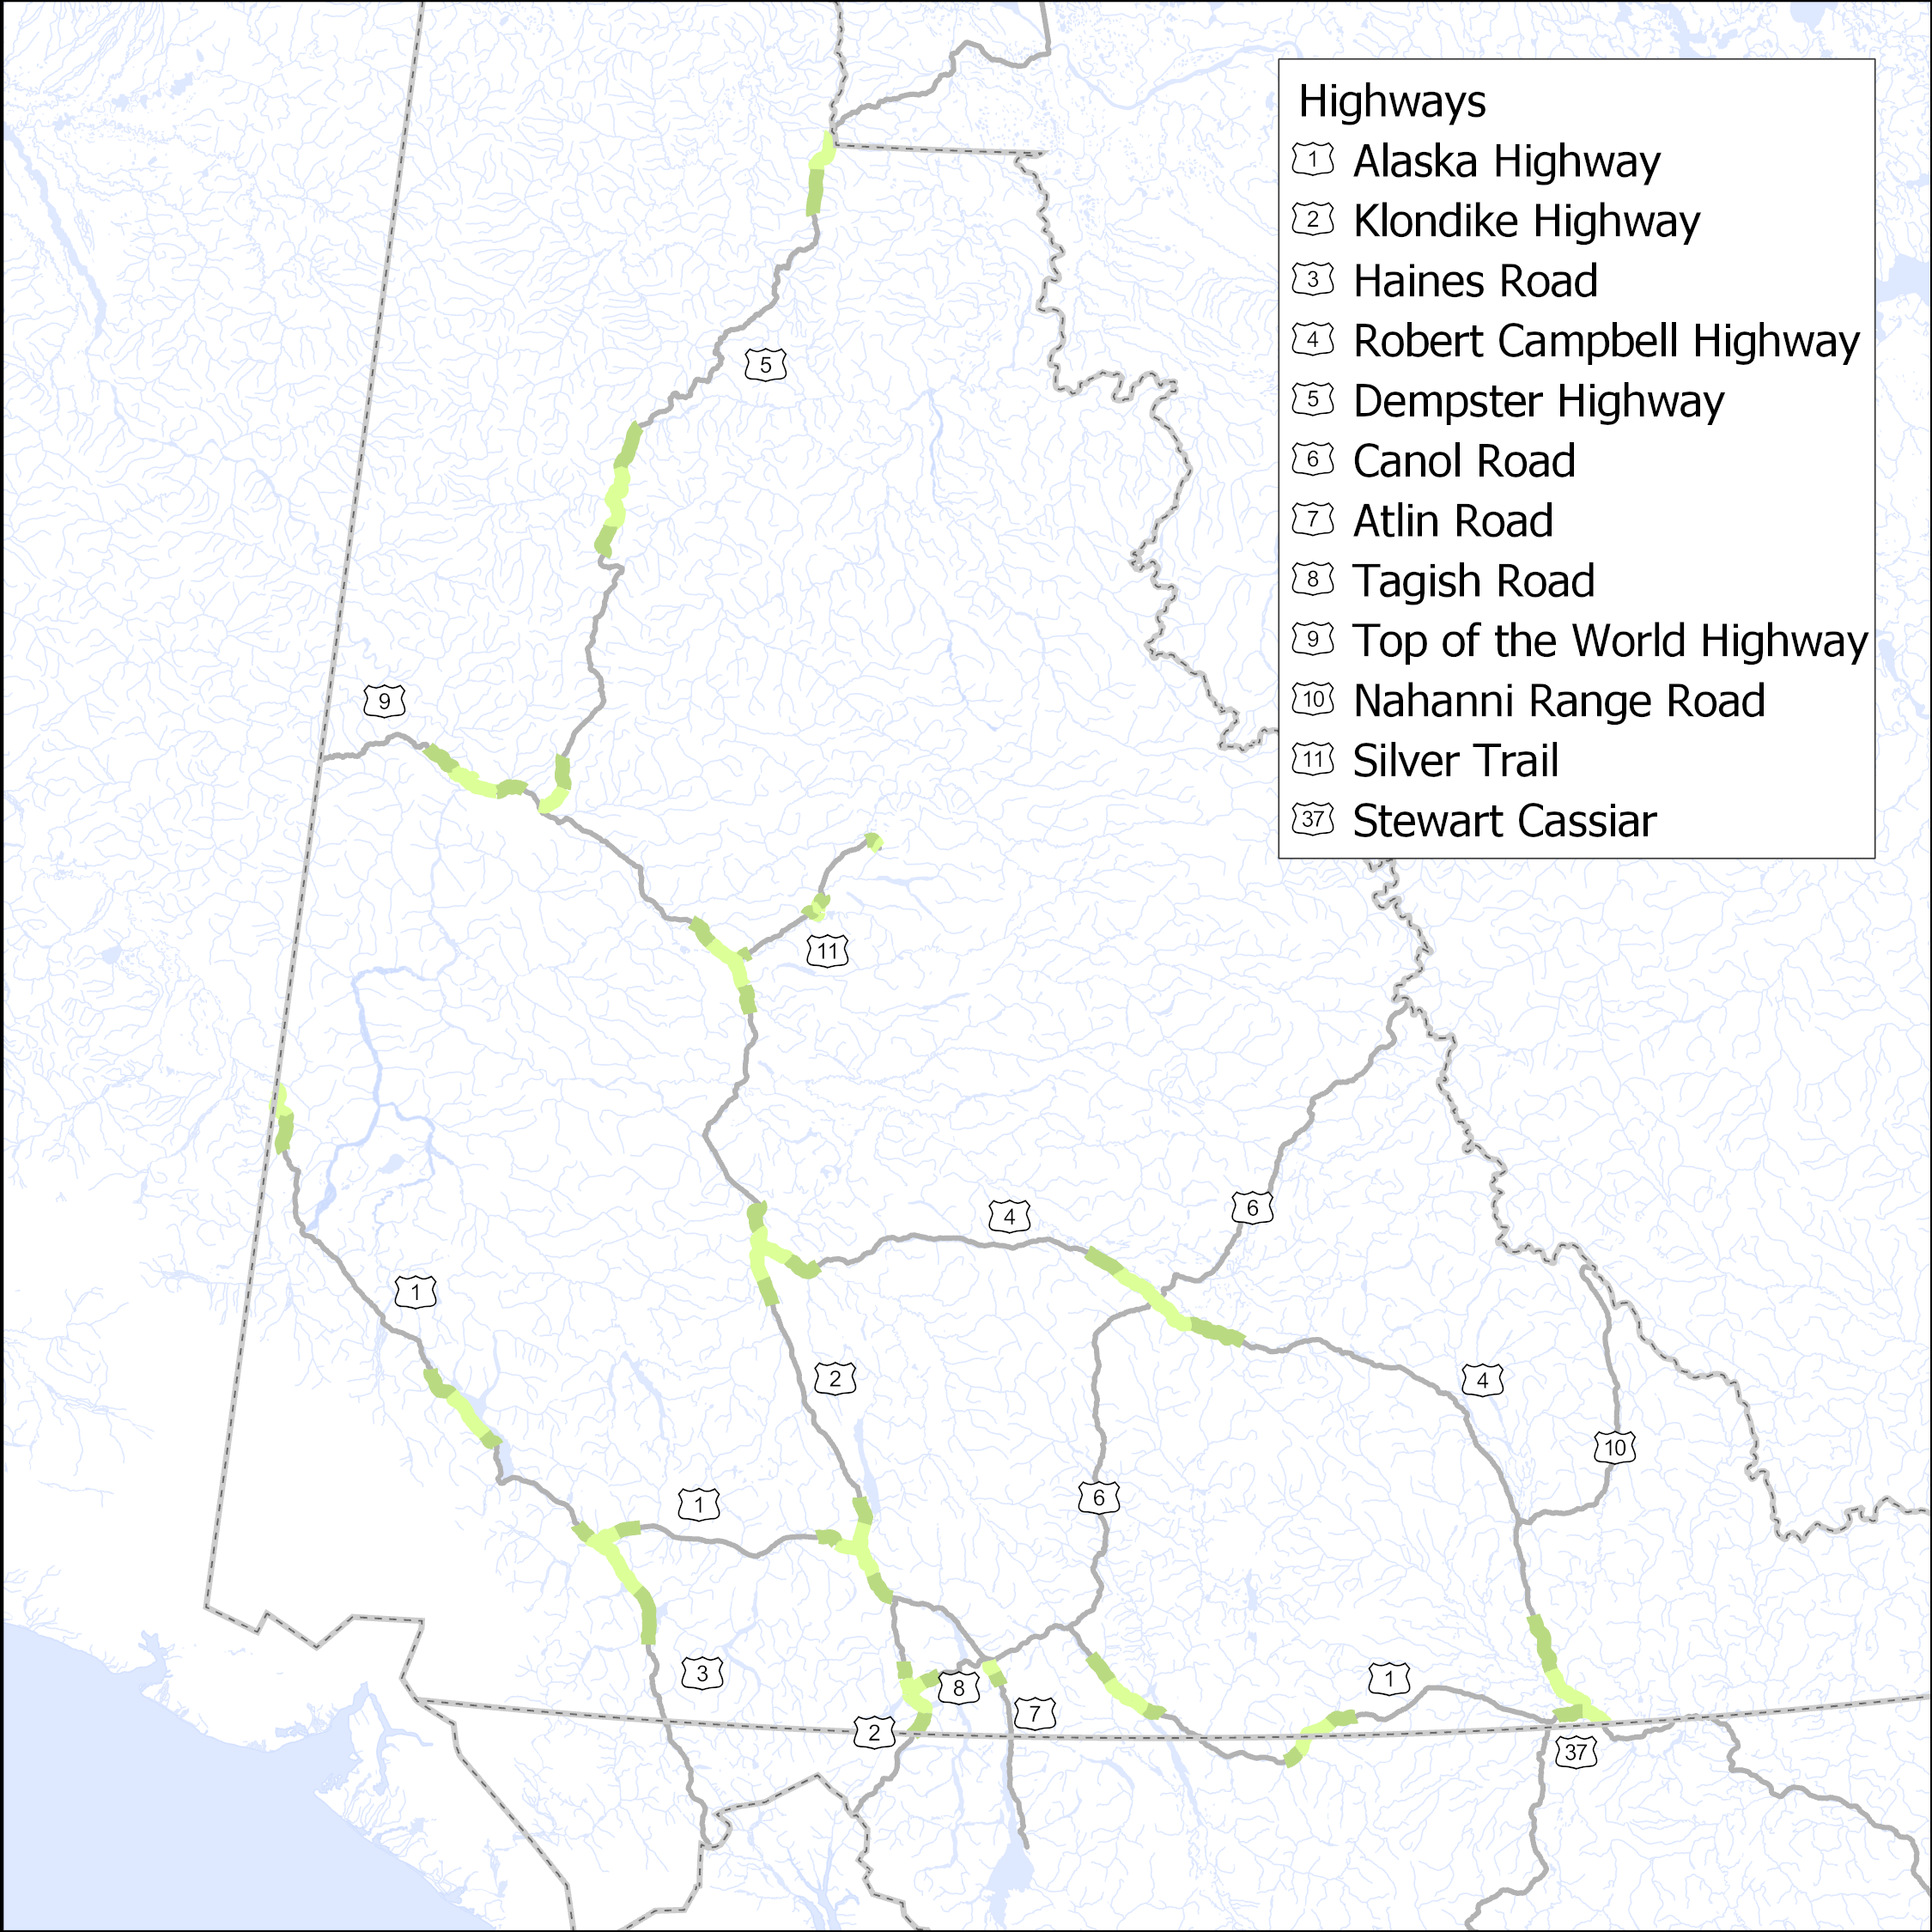
VMS: Year 2 of 6

Slide 25

VMS: Year 3 of 6

Slide 26
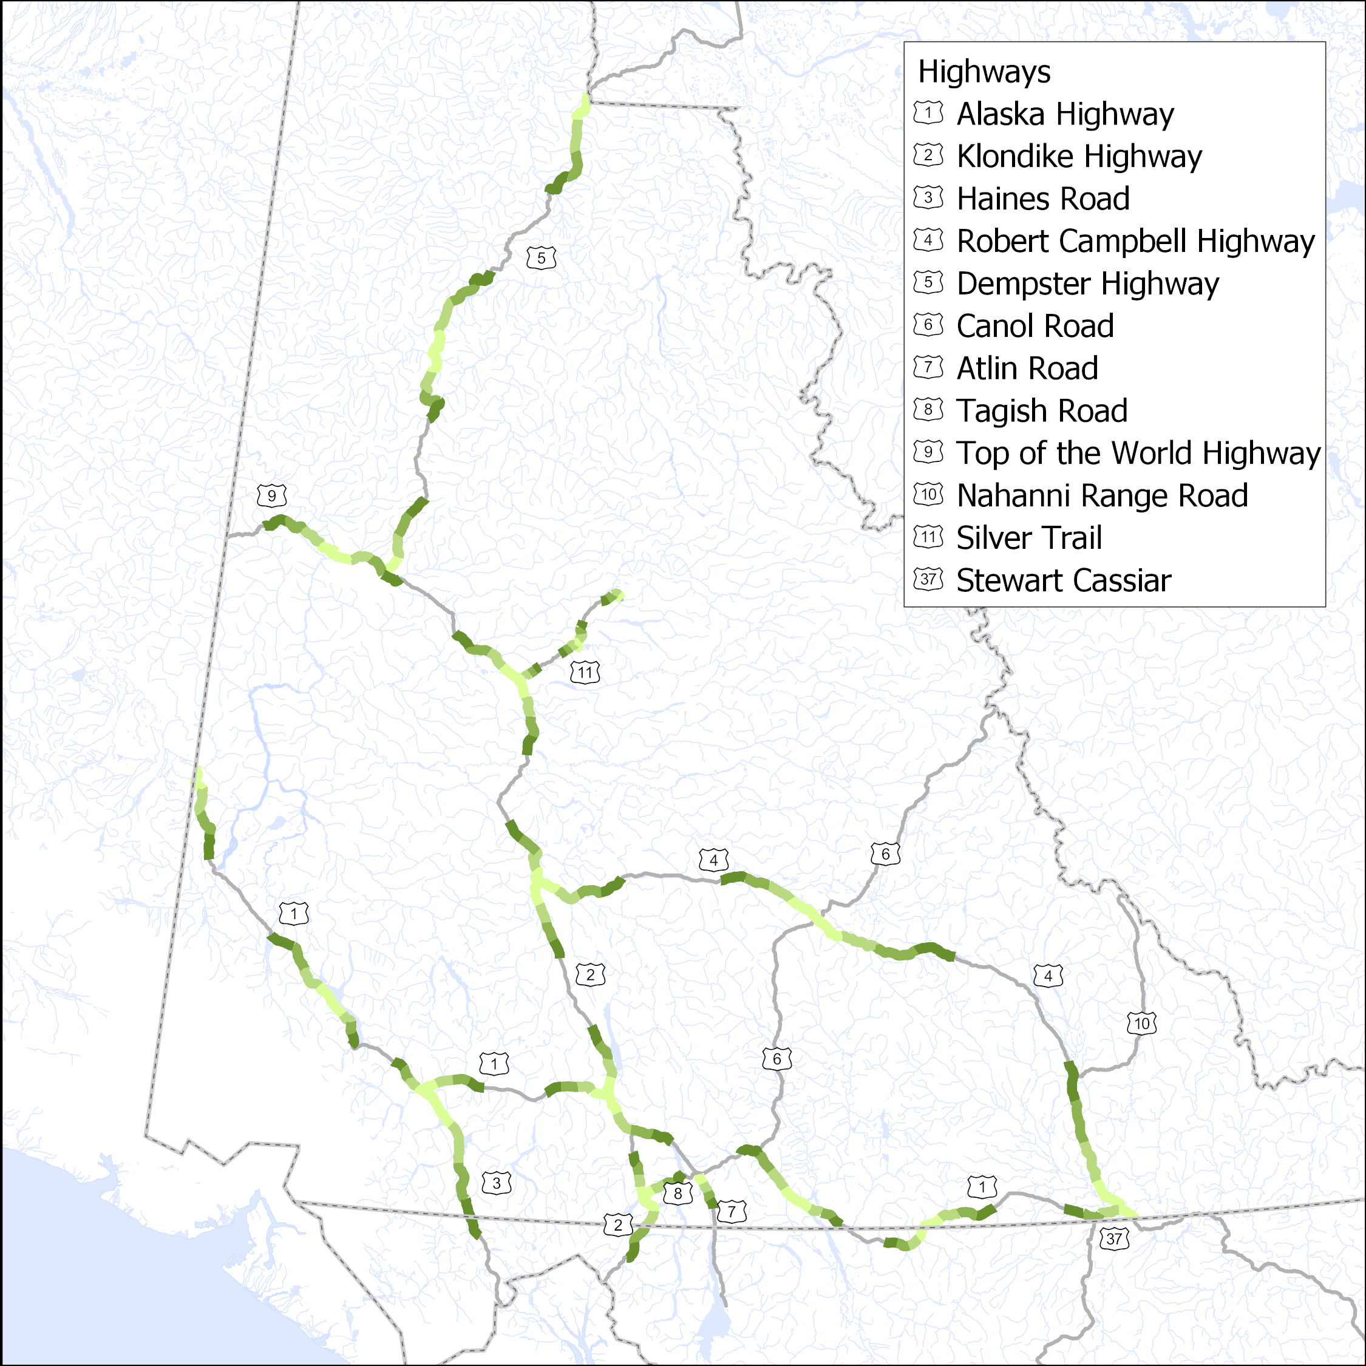
VMS: Year 4 of 6

Slide 27
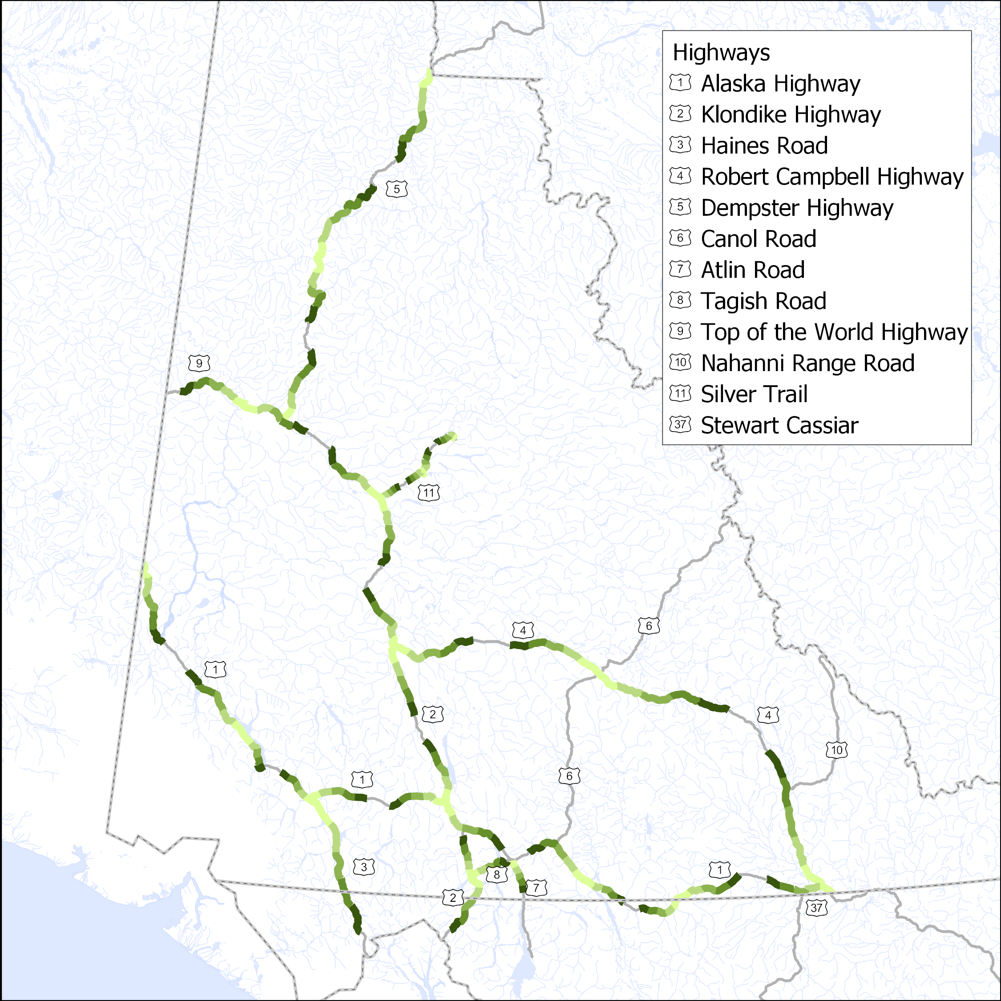
VMS: Year 5 of 6

Slide 28
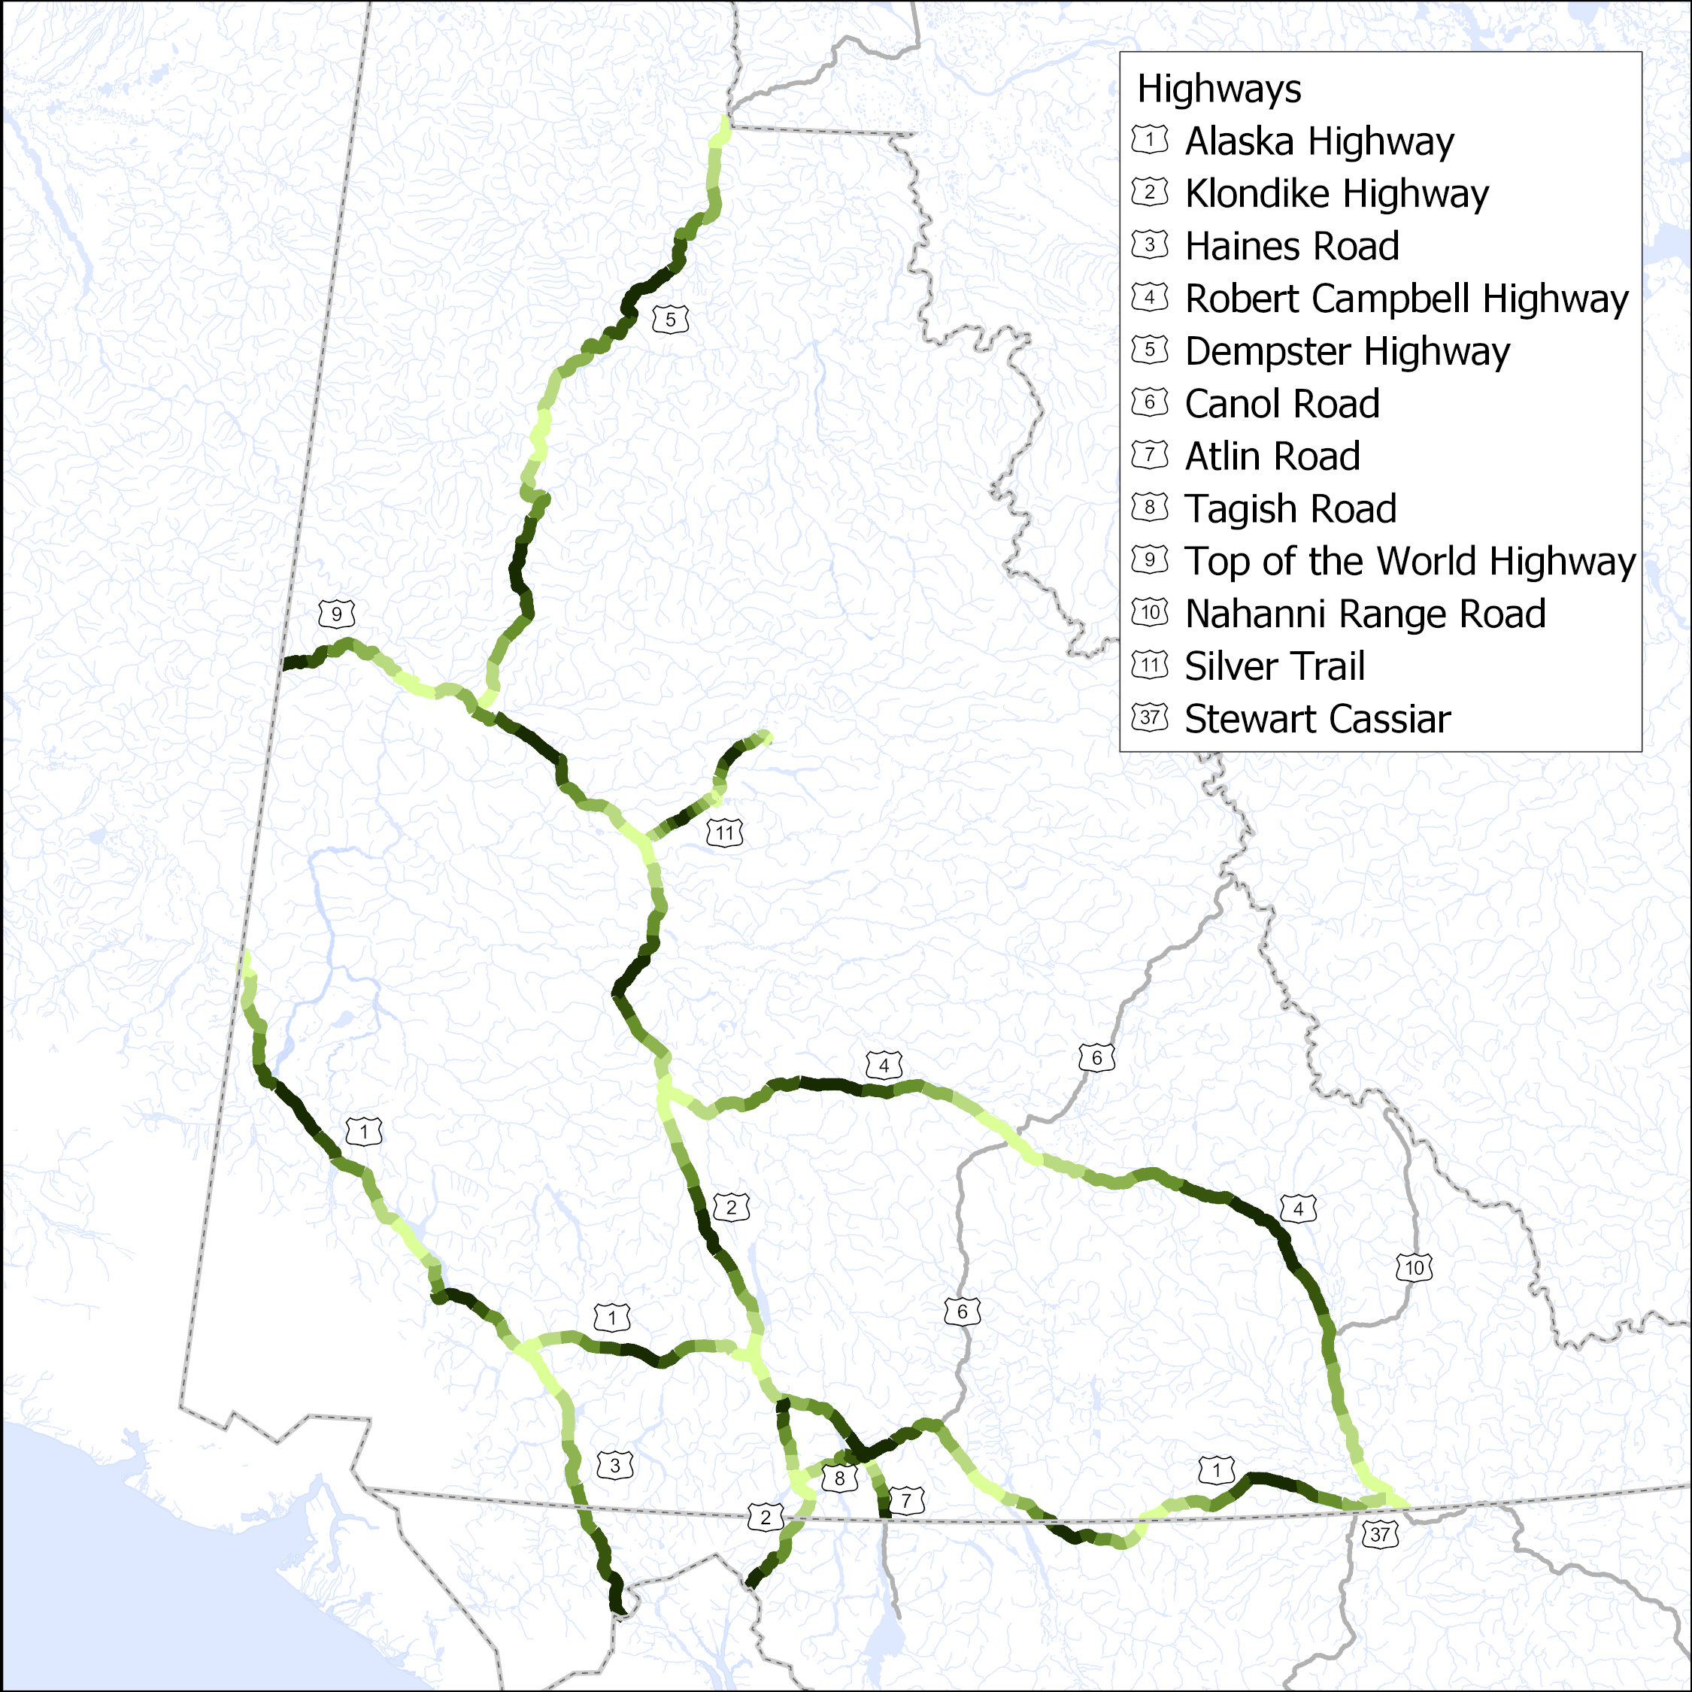
VMS: Year 6 of 6

Slide 29
Expected Benefits
Improved highway safety
  Visibility
  Wildlife
Increased highway life cycle
Effective budget allocation
Notes:
The benefits of the VMS program will include:
Improved safety – drivers will be able to see farther and have advanced warning for wildlife.
Increased highway life cycle – better drainage and management of root systems will slow highway degradation, reducing maintenance costs.
Effective budget allocation – because having a plan for the system makes the expenditure more predictable, and segments aren’t left behind
Almost 3x cost for over 3.5x work
In order to bring up the network condition to the point where this cycle can begin, we will need to complete six years of deferred brushing projects at a cost of $3.5M per year. After that, this repeating cycle will cost $2M per year for the exact same amount (ha) of brushing work as the network be in good standing.

Slide 30
Example:
Line Painting Program

Slide 31
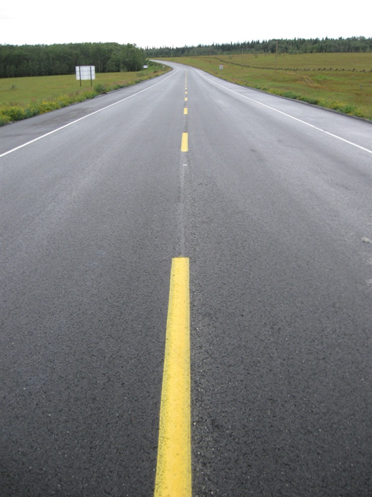
Line Painting Program
Denote highway lanes
Past: “worst first” as budget allowed
Future: Formalized rating and schedule
Notes:
Painted highway lines show drivers the location of lanes. They communicate the edge and centre of the road, and whether passing is permitted.
In past years, painting has been done on a “worst-first” basis in consideration with prioritizing sections of highway that are scheduled to receive Bituminous Surface Treatment that year. Severely degraded areas which could be scheduled with BST line painting were given priority. Other degraded areas in the network may not receive treatment.
Arrow, gores lines and crosswalks completed on an ad-hoc basis (i.e. only in a few communities annually as scheduling and budget allowed).
No sweeping of roads occurred prior to painting over existing lines.
Priority areas were identified and completed based on what the limited budget would allow. Past budget approx. 600k annually funded through TMB O&M.
This led to discontinuous painted areas, and some segments went longer than acceptable without being redone.
TMB stopped using Hi VOC Paints in 2012 and switched over to the Low VOC paint due to new environmental regulations. There are three major differences between the paint
Hi VOC paint has better longevity they had said 1-2 years depending on traffic volumes
Hi VOC was able to be used in smaller volumes to achieve this, approximately 25% less.
Hi VOC was able to be effectively applied at lower temperatures therefore expanding our possible season
The program we are currently developing will see the entire network repainted on a regular schedule. The network will be rated on a 1 to 5 scale. These photos demonstrate what each rating represents.
Options study to be a northern jurisdictional review for line painting including best practices, paint types and volumes, options such as thermoplastics, rain line, etc. , etc. To be included into lane delineation study.

Slide 32
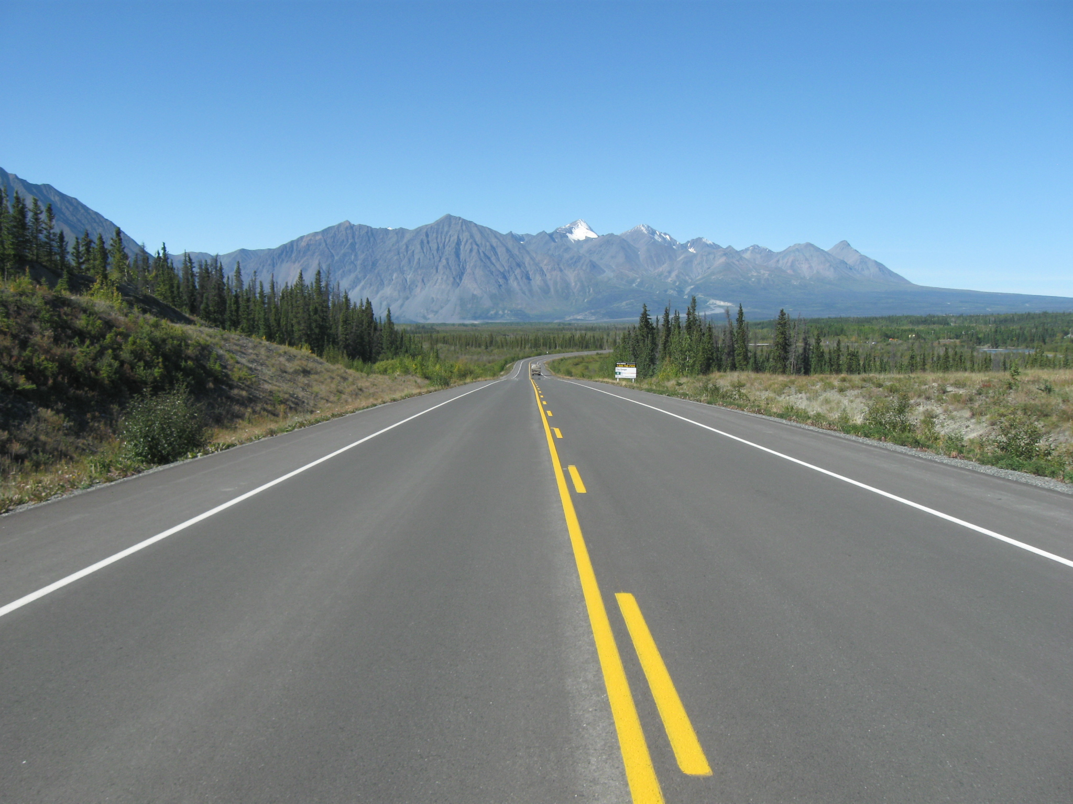
Rating: 5
Notes:
5 Clear bright lines, most bead embedment remaining.

Slide 33
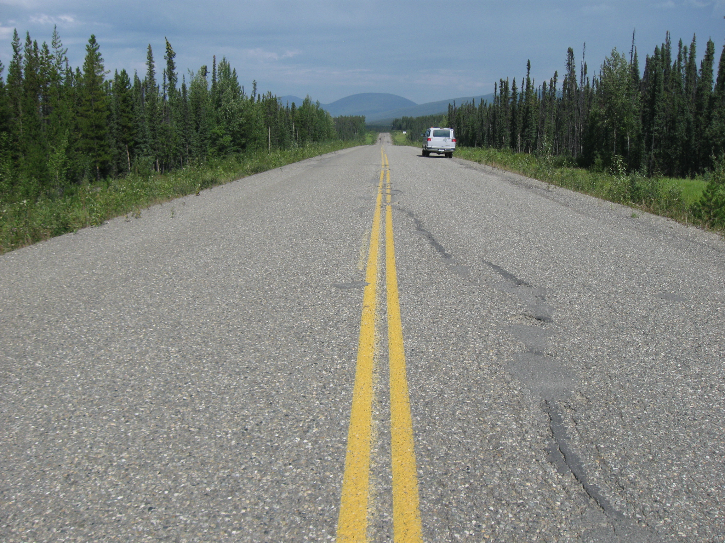
Rating: 4
Notes:
4 Barely faded lines, partially faded in patches (corners), some bead embedment remaining.

Slide 34
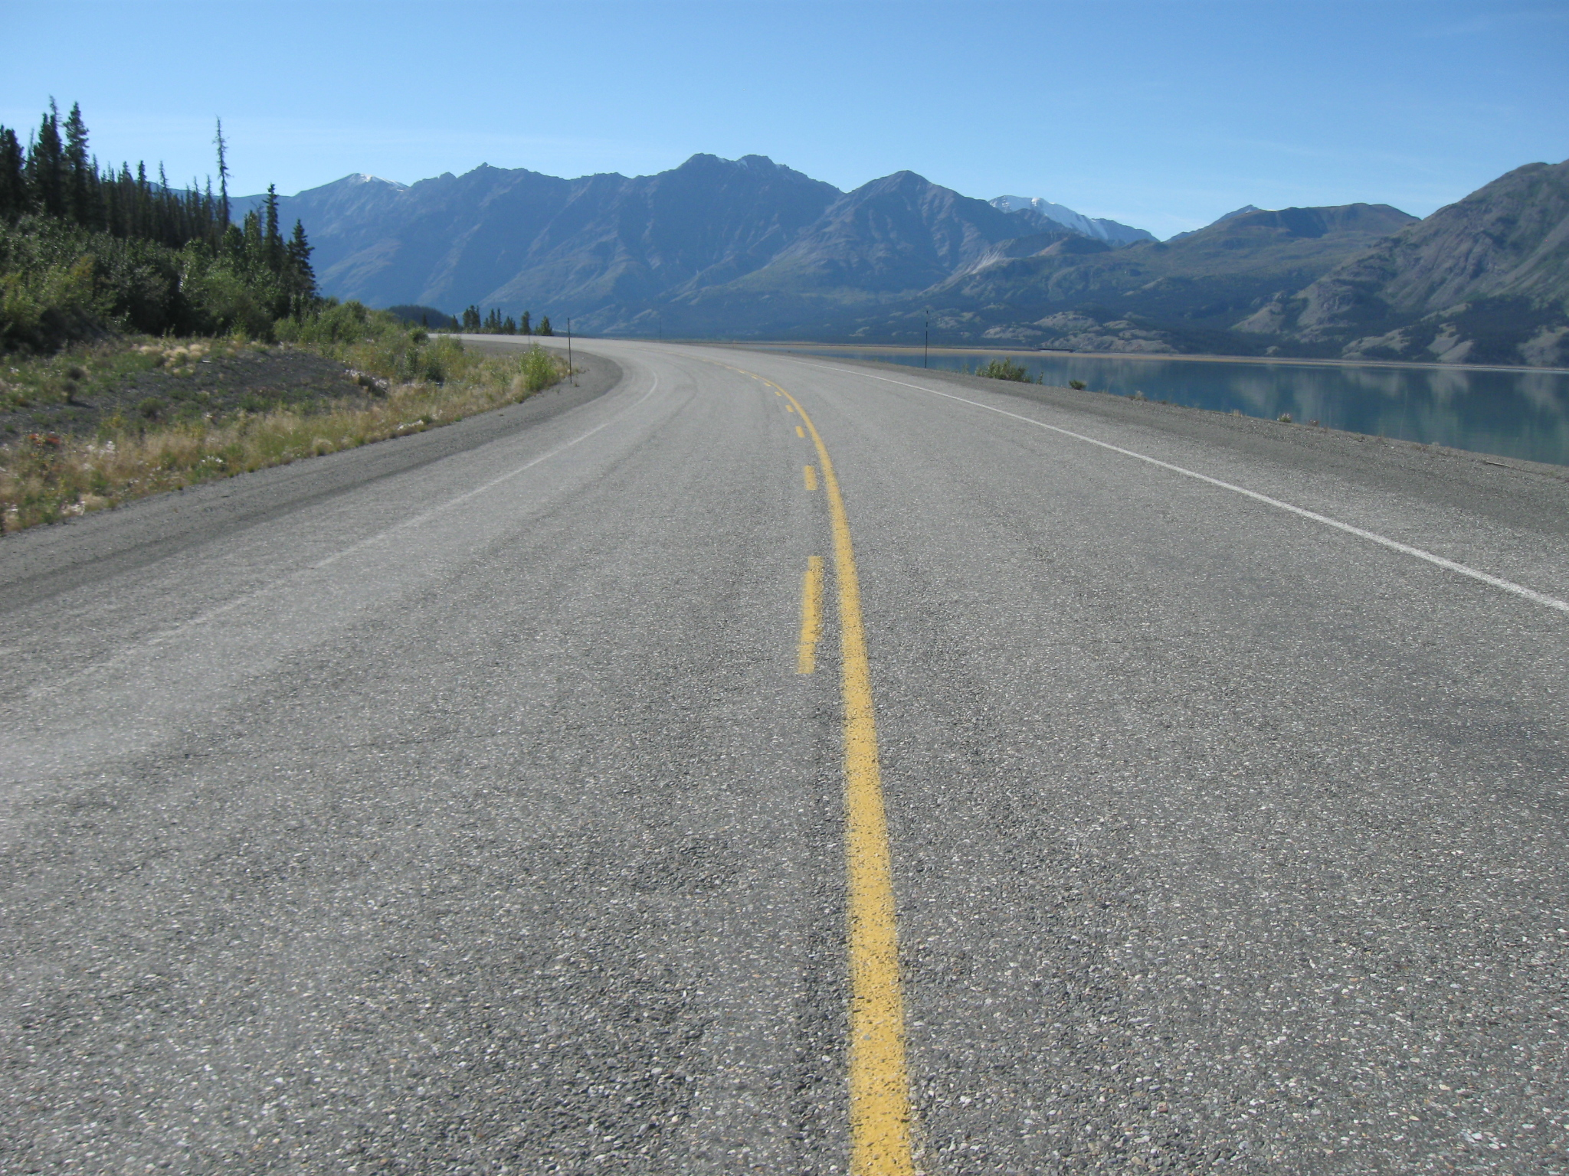
Rating: 3
Notes:
3 Partially faded lines, mostly/severely faded in patches (corners), no bead embedment remaining.

Slide 35
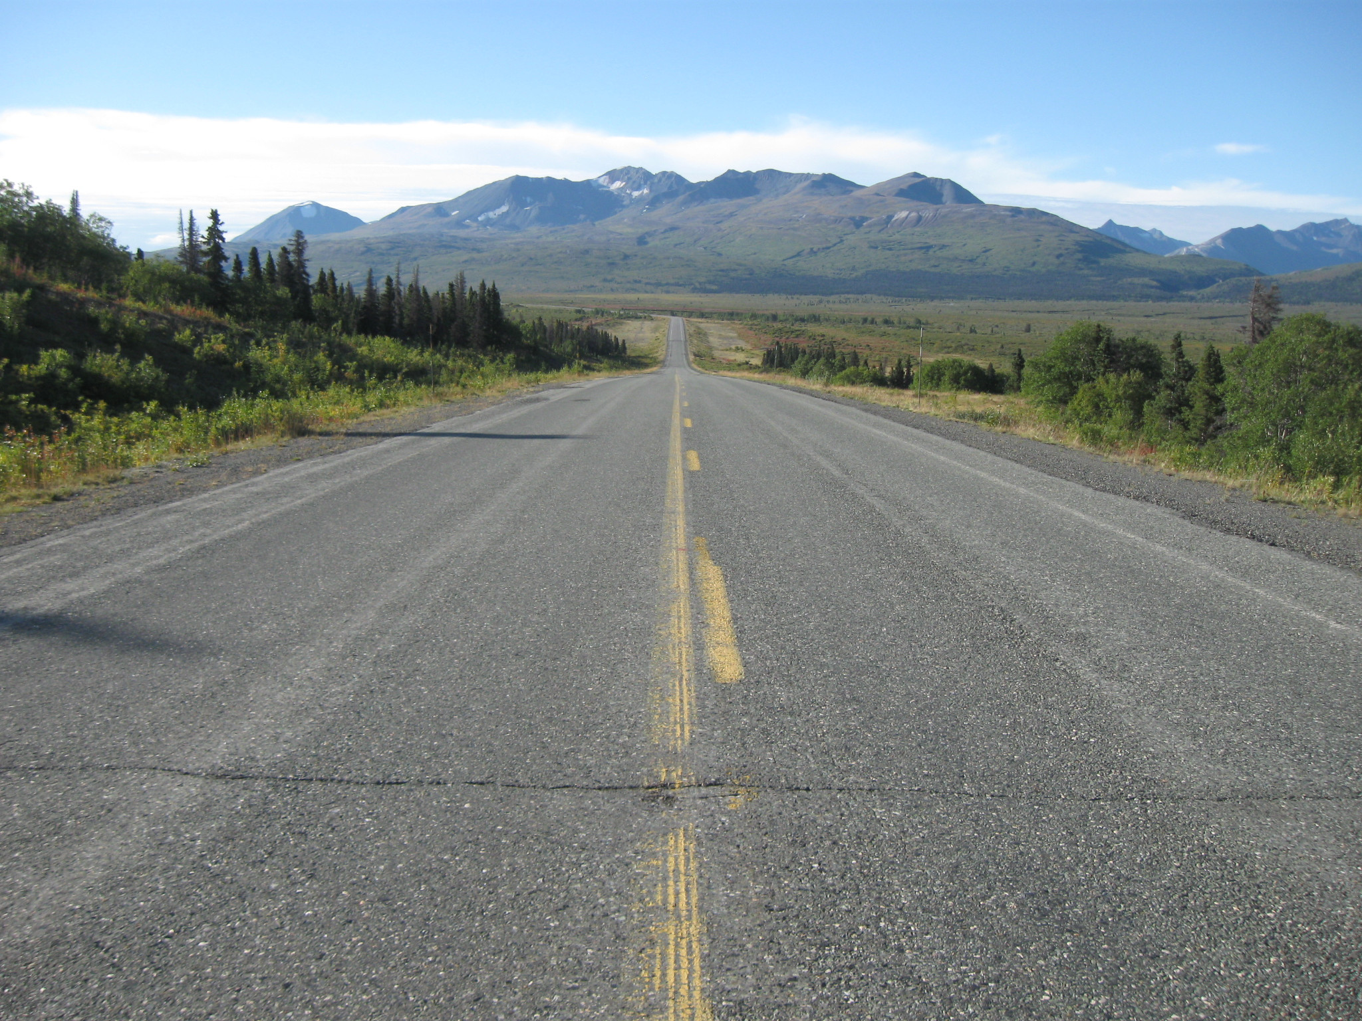
Rating: 2
Notes:
2 Mostly faded lines, non-existent in patches (corners), no bead embedment remaining.

Slide 36
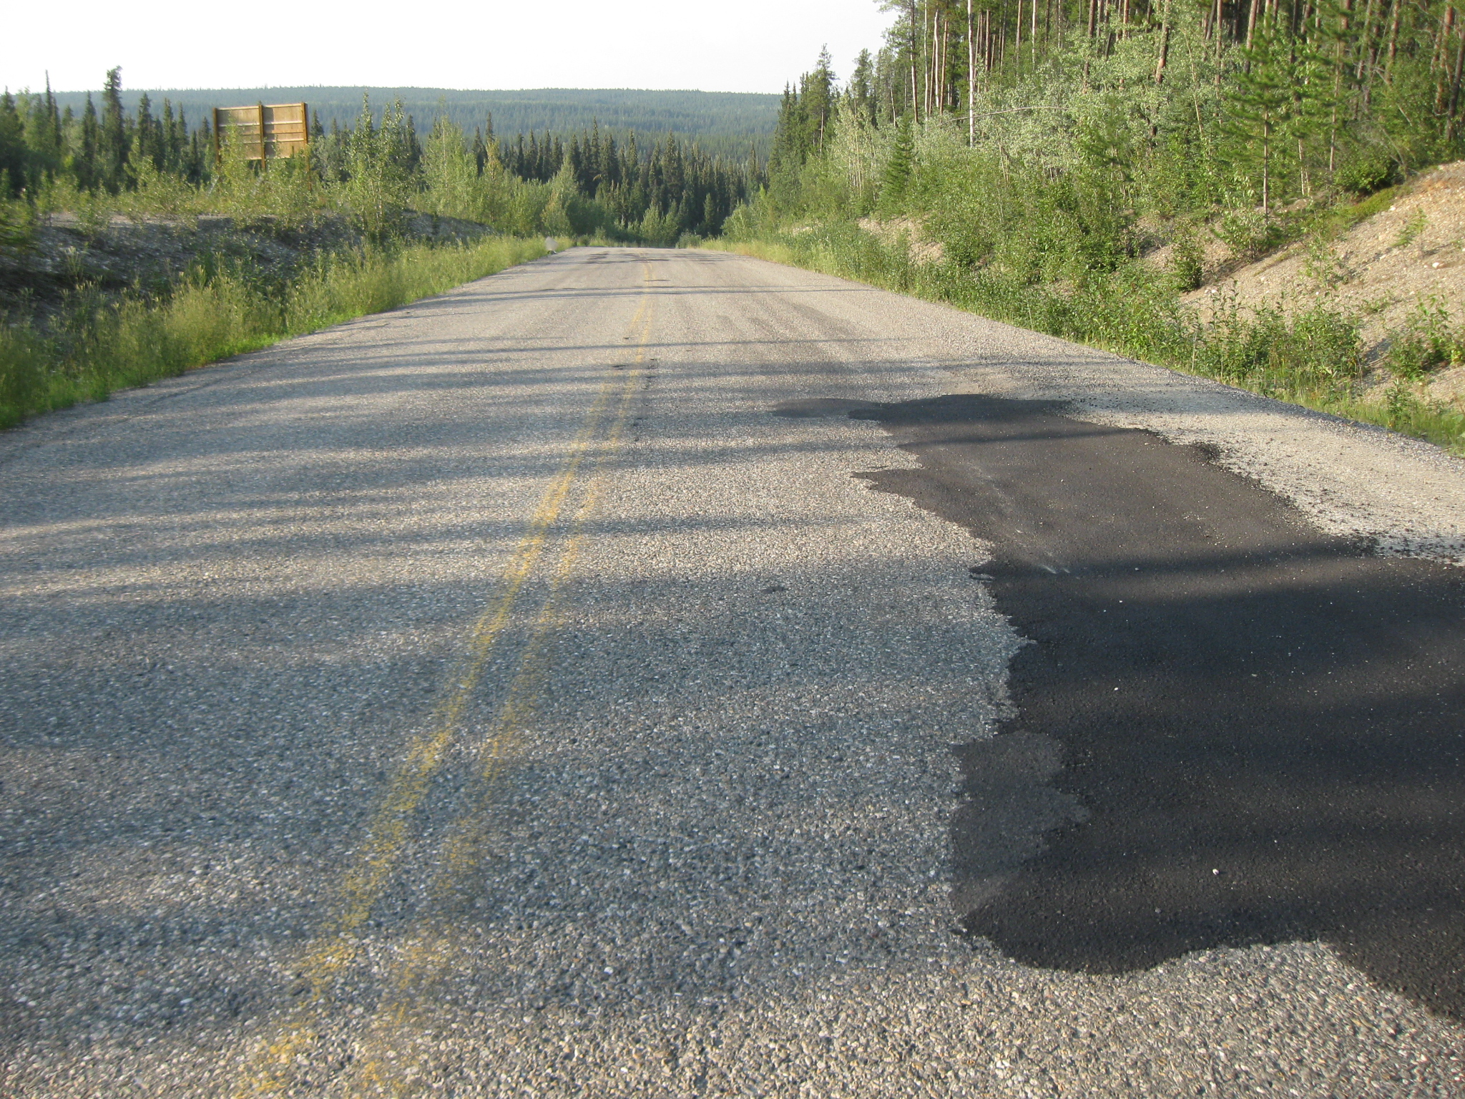
Rating: 1
Notes:
1 Severely faded or non-existent lines, no bead embedment remaining.

Slide 37
Rating: 1
Rating: 2
Rating: 3
Rating: 4
Rating: 5
Notes:
1 Severely faded or non-existent lines, no bead embedment remaining.
2 Mostly faded lines, non-existent in patches (corners), no bead embedment remaining.
3 Partially faded lines, mostly/severely faded in patches (corners), no bead embedment remaining.
4 Barely faded lines, partially faded in patches (corners), some bead embedment remaining.
5 Clear bright lines, most bead embedment remaining.

Slide 38
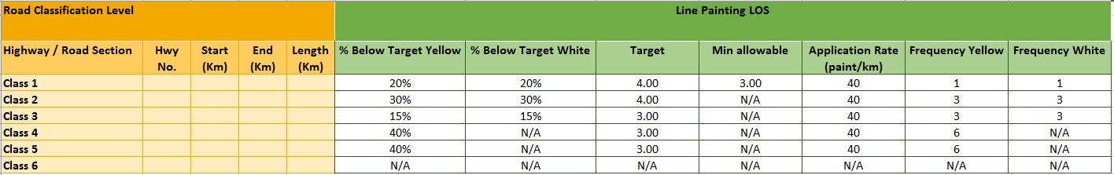
Level of Service
Six categories for highway functional classifications
Technical LOS target for each highway category

Slide 39
Expected Benefits
Higher quality/longer lasting
  Sweeping
  Thicker paint application
  Annual arrows/gores/crosswalks
Improved safety standard
Increased painting amount
Effective budget allocation
Notes:
Under this plan, significant benefits will be seen in the network.
The lines painted under this plan will be of higher quality and will endure longer for two main reasons:
We will be implementing a sweeping crew to remove debris from the road. The paint truck has air blowers that remove small particles, but large gravel pieces leftover from winter sanding remain. They block paint from reaching the road surface and reduce the quality of application. The sweeper crew will enable a clean painting surface for better adhesion.
In the 2017 season the thickness of paint was varied to find the ideal rate that didn’t lead to blowout (too much paint) or insufficiently bright lines (too little paint). The ideal rate was found to be 40L/km. This is what is budgeted for in the proposed plans.
Annual arrows, crosswalks, gores lines in every community.

Slide 40
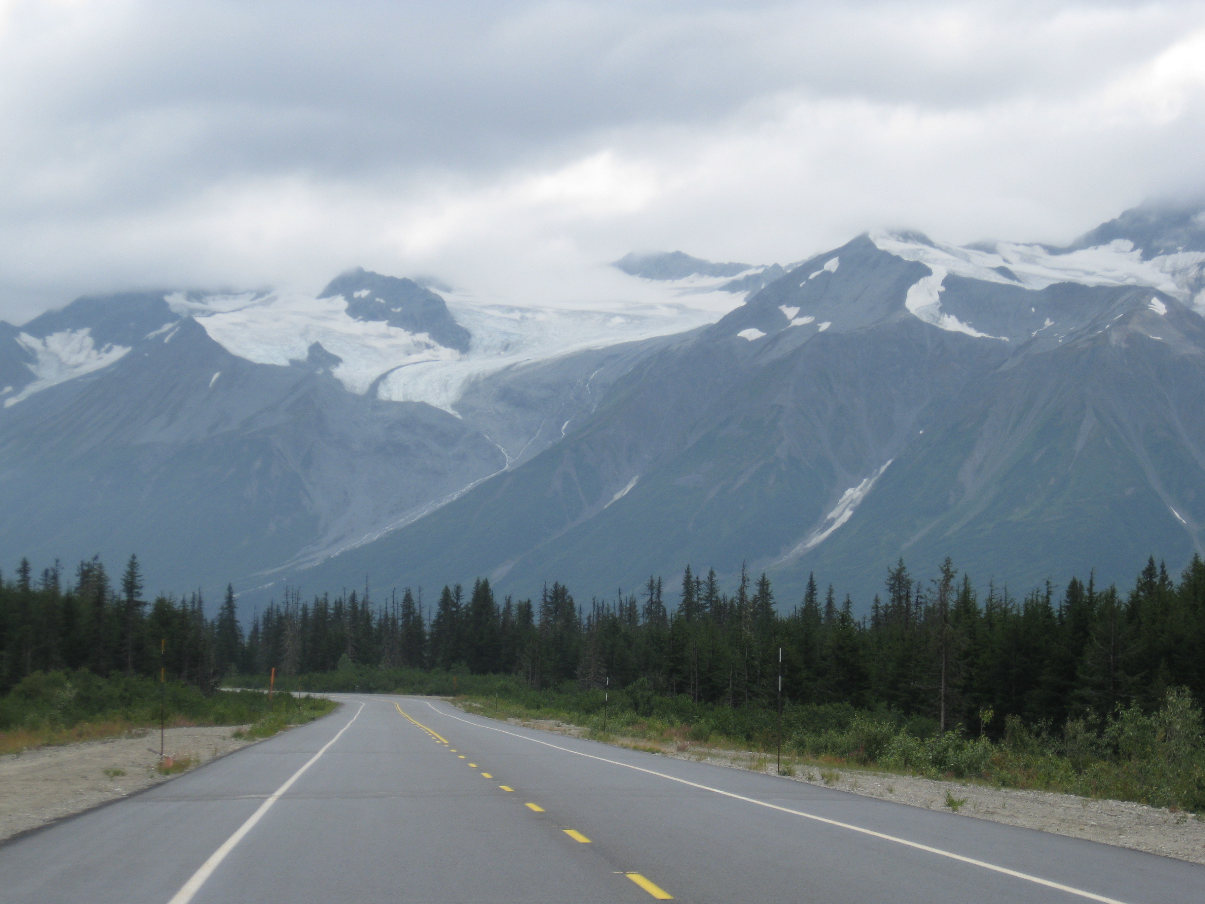
Notes:
end

